Slide 1





Amazon Sales Data Analysis
Amazon is the world's largest e-commerce platform, offering a vast array of products and services to customers globally. This analysis will dive into Amazon's sales data, exploring its diverse revenue streams, top-selling product categories, and innovative pricing strategies to uncover key insights for data-driven decision making.
by Nikhil Yadav

Slide 2
Overview of Amazon's Business Model
E-Retail
Third-Party Sellers
Other Segments
Amazon's core business is its e-commerce platform, where customers can purchase a wide range of products directly from the company.
Amazon also enables third-party sellers to list and sell their products on the platform, generating additional revenue streams.
Beyond e-commerce, Amazon has diversified into cloud computing, digital content, and other services, contributing to its overall financial success.

Slide 3

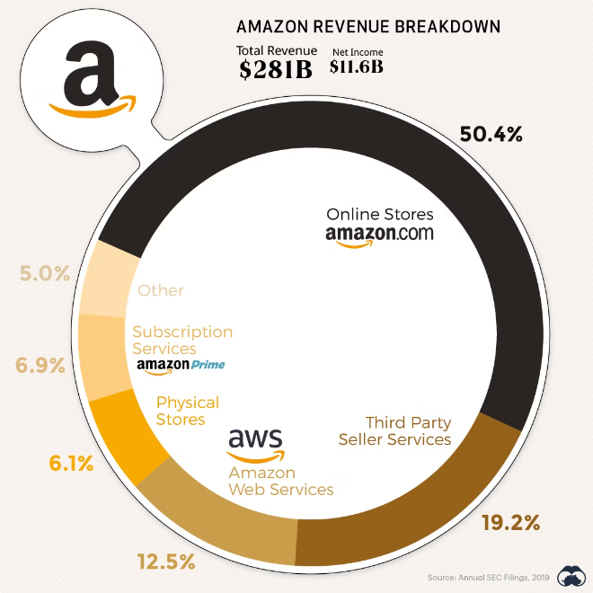
Key Revenue Streams: E-Retail, Third-Party Sellers, and Other Segments
1
E-Retail
Direct online sales of a wide range of consumer products, including electronics, home goods, apparel, and more.
2
Third-Party Sellers
Commission-based revenue generated from independent sellers using Amazon's platform to reach a vast customer base.
3
Other Segments
Additional revenue streams such as Amazon Web Services (cloud computing), advertising, subscription services, and more.

Slide 4

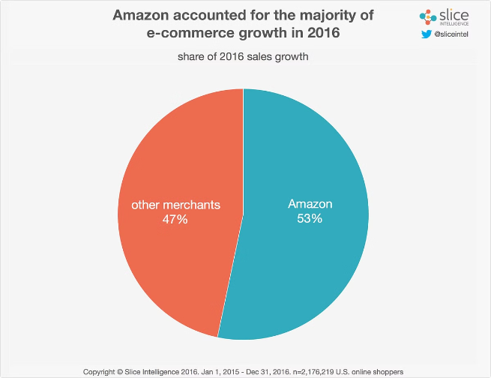
Analyzing Amazon's Sales Trends and Growth Patterns
1
Exponential Growth
2
Seasonality Factors
Amazon has experienced remarkable year-over-year growth in sales, with a CAGR of over 25% in the past decade.
Amazon's sales are influenced by seasonal trends, with peak periods around major holidays and shopping events.
3
Geographic Expansion
4
Market Dominance
Amazon's global footprint has expanded significantly, with sales now generated in multiple international markets.
Amazon's continued growth has solidified its position as the leading e-commerce platform globally.

Slide 5
Understanding Product Categories and Sales Performance
Top-Selling Categories
Emerging Trends
Niche Segments
Amazon's best-selling product categories include electronics, home and kitchen, apparel, and books/media.
New categories like health and personal care, pet supplies, and home improvement are seeing rapid growth.
Amazon also caters to specialized interests, such as automotive parts, industrial supplies, and luxury goods.

Slide 6

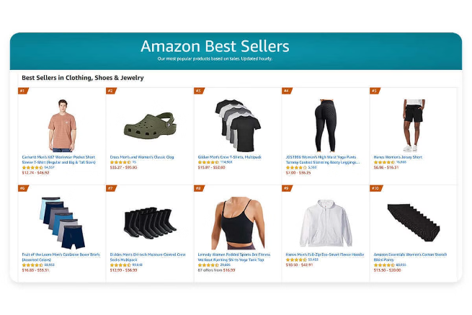
Identifying Top-Selling Products and Emerging Trends
Best-Sellers
New Launches
Amazon's best-selling products often include consumer electronics, home appliances, and Amazon's own branded devices.
Amazon closely monitors customer demand and rapidly introduces new products to capitalize on emerging trends.
Fastest-Growing
Customer Reviews
Categories like smart home technology, fitness equipment, and sustainable products are experiencing exponential growth.
Product reviews and ratings play a crucial role in driving sales and customer loyalty on the Amazon platform.

Slide 7

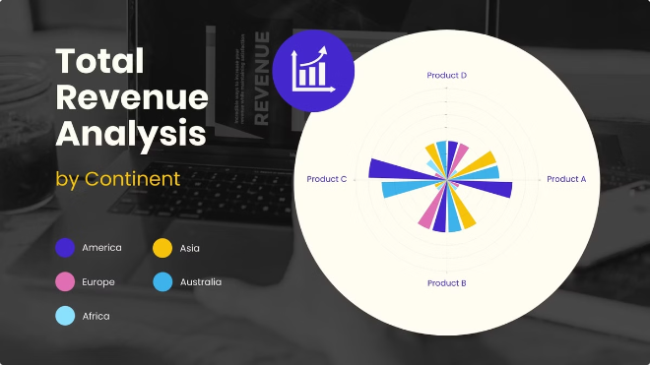

Insights into Amazon's Pricing Strategies and Competitive Landscape
Dynamic Pricing
Competitive Monitoring
Amazon employs sophisticated algorithms to adjust prices based on demand, competition, and other market factors.
Amazon closely tracks pricing and offerings from competitors to ensure it remains the most attractive option for customers.
Customer Loyalty
Marketplace Dominance
Amazon's Prime membership program and personalized recommendations help drive customer loyalty and repeat business.
Amazon's position as the leading e-commerce platform gives it significant leverage over suppliers and third-party sellers.

Slide 8

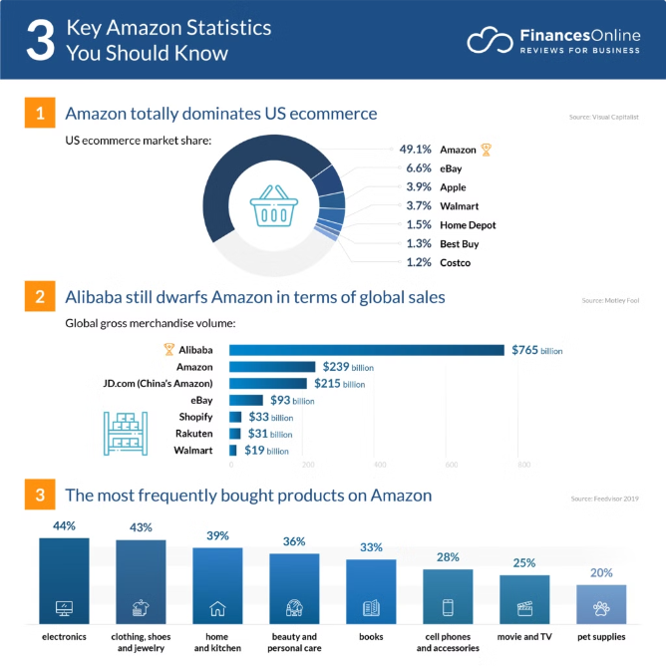




Conclusion and Recommendations for Data-Driven Decision Making
Understand Key Drivers
Analyze sales data to identify the main factors influencing Amazon's revenue growth and profitability.
Optimize Product Mix
Leverage insights on top-selling categories and emerging trends to refine product offerings and inventory strategies.
Enhance Pricing Strategies
Utilize Amazon's dynamic pricing capabilities and competitive data to maximize revenue and margins.
Leverage Data-Driven Insights
Continuously monitor and analyze Amazon's sales data to inform strategic decision-making and drive long-term growth.

